Slide 1

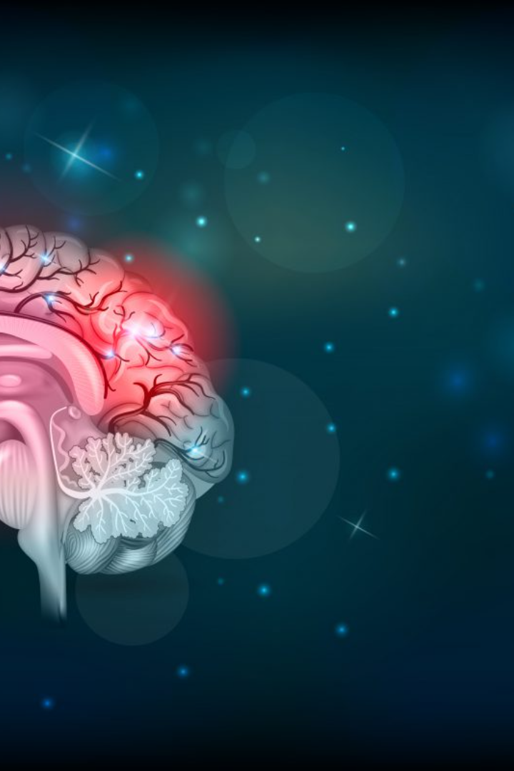
Brain Stroke Image Recognition using OpenCV
Discover how OpenCV is revolutionizing the field of brain stroke image recognition and processing, leading to faster and more accurate diagnoses.

Slide 2

Introduction
Good morning, ladies and gentlemen. Today, I actually we are excited to present a topic that holds immense potential in revolutionizing the field of healthcare – "Brain Stroke Image Recognition using OpenCV."
Every year, millions of lives are impacted by strokes, a medical emergency that demands swift and accurate diagnosis for effective treatment. The ability to identify and process brain stroke images rapidly can make a significant difference in patient outcomes. This is where the integration of OpenCV, the Open Source Computer Vision Library, comes into play.
In our presentation, we'll delve into the motivation behind this project, the significance of addressing this critical medical need, the challenges involved, and the remarkable potential that OpenCV brings to the table. Let's embark on a journey to explore the intersection of medical imaging, artificial intelligence, and open-source technology in the context of brain stroke recognition.
Shall we begin?

Slide 3
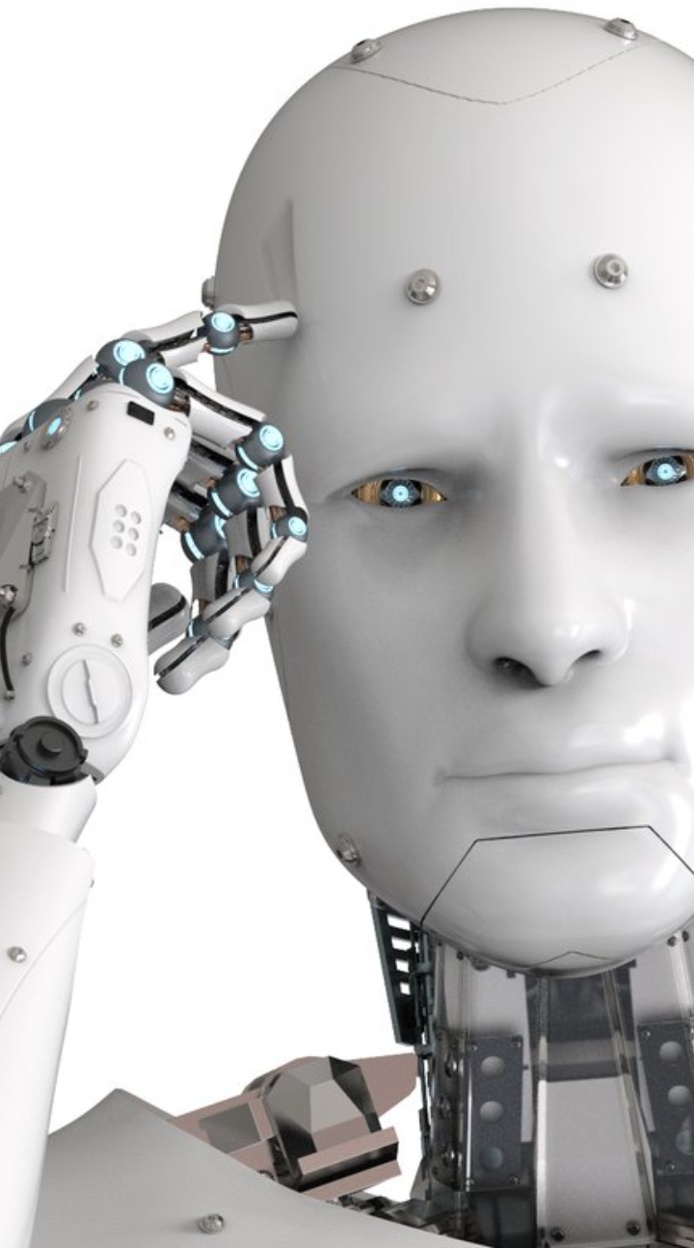
Objective of the Research
The primary objective of this research is to develop and implement an automated system for the detection of brain strokes using computer vision techniques, specifically leveraging the OpenCV library. The project aims to address critical challenges in the timely and accurate diagnosis of strokes, contributing to improved patient outcomes and healthcare efficiency. The specific objectives are as follows:
Automated Stroke Detection:
Develop a robust algorithm using OpenCV for automated detection of stroke-related abnormalities in medical images, such as CT or MRI scans.
Image Pre-processing and Feature Extraction:
Implement advanced image pre-processing techniques to enhance the quality of medical images.
Extract relevant features from the pre-processed images to facilitate accurate identification of stroke-related lesions.
Classification and Segmentation:
Utilize machine learning techniques, possibly integrated with OpenCV, for the classification and segmentation of stroke regions within medical images.
Integration with Healthcare Systems:
Design the system to seamlessly integrate with existing healthcare infrastructure, ensuring practical applicability in clinical settings.
Real-time Processing:
Optimize the algorithm for real-time image processing, minimizing delays in stroke detection and enabling swift clinical decision-making.
Accuracy and Sensitivity Improvement:
Evaluate and enhance the accuracy and sensitivity of stroke detection through iterative testing and refinement of the algorithm.

Slide 4
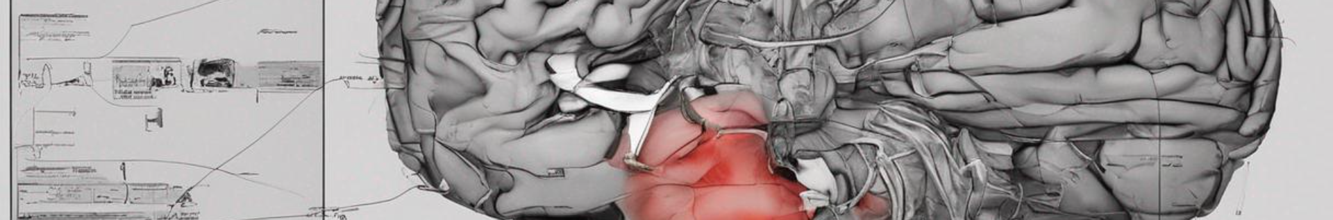
Explanation of Brain Stroke
A brain stroke, a medical emergency caused by disrupted blood supply to the brain, necessitates prompt and accurate diagnosis for effective treatment. In our presentation, we will explore how OpenCV, an open-source computer vision library, becomes a powerful ally in automating the recognition and processing of brain stroke images.
Our journey will take us through the critical significance of timely stroke diagnosis, the complexities involved in analyzing medical images manually, and why we have chosen OpenCV as our tool of choice. Furthermore, we will uncover the potential industrial applications, discussing how this technology can be a game-changer in healthcare.
By the end of our presentation, we will gain insights into how the synergy of medical imaging and advanced computer vision techniques, particularly with OpenCV, is paving the way for faster, more accurate, and potentially life-saving diagnoses in the realm of brain strokes.

Slide 5
Overview of Image Recognition and Processing
Image recognition, a subset of computer vision, is the process of teaching machines to interpret and understand visual information. It involves developing algorithms and models capable of identifying objects, patterns, or features within images. This technology mimics the human ability to recognize and categorize visual stimuli, enabling computers to "see" and make informed decisions based on visual data.
On the other hand, image processing involves the manipulation and enhancement of images to extract meaningful information or improve visual quality. It encompasses a wide range of techniques, including filtering, segmentation, and noise reduction, aimed at refining raw visual data for analysis or presentation.

Slide 6

OpenCV Libraries and Tools
In our exploration of "Brain Stroke Image Recognition using OpenCV," it's crucial to understand the powerful libraries and tools that OpenCV offers. Let's take a brief look at the key components that will be instrumental in developing this innovative solution:
1. OpenCV (Open Source Computer Vision Library):
a. Core Functionality:
OpenCV is an open-source computer vision and machine learning library renowned for its extensive collection of tools and functions.
It provides a robust foundation for image and video processing, making it a go-to choice for a wide range of computer vision applications.
b. Image Processing Modules:
Image Filtering
Morphological Operations
Contour Detection
c. Feature Detection and Description:
Feature Detection Algorithms
ORB (Oriented FAST and Rotated BRIEF)
2. Machine Learning Module:
a. SVM (Support Vector Machine):
A supervised learning algorithm suitable for classification tasks. It can be utilized for training the system to distinguish between stroke and non-stroke regions in brain images.
3. Computer Vision Algorithms:
a. Contour Analysis b. Edge Detection
4. Real-time Image Recognition:
a. Integration with OpenCV:
OpenCV's real-time image processing capabilities allow for the seamless integration of trained machine learning models into live applications.
Integration involves applying the developed algorithms to incoming video or image streams for instant stroke recognition.
5. Data Visualization:
a. Matplotlib (Optional):
While not a part of OpenCV, Matplotlib is a popular data visualization library in Python. It can be used for visualizing image processing results and model performance.
OpenCV's comprehensive suite of tools empowers developers to build sophisticated image recognition and processing applications. From fundamental image manipulation to advanced machine learning integration, OpenCV provides the essential components for our project on brain stroke image recognition.
As we delve into the implementation, the versatility and efficiency of these OpenCV libraries and tools will become apparent in achieving our goal of accurate and rapid brain stroke diagnosis.
Thank you for your attention, and let's proceed with the application and the challenges of our project.

Slide 7

Applications and challenges:
The applications of image recognition and processing are vast and span various industries:
Healthcare: Medical image analysis, disease diagnosis.
Automotive: Object detection for autonomous vehicles.
Retail: Facial recognition for customer analytics.
Security: Surveillance and biometric identification.
Entertainment: Augmented reality and image-based gaming.
Despite remarkable advancements, challenges persist, including:
Data Quality: The accuracy of image recognition models heavily depends on the quality and diversity of training data.
Computational Resources: Some image processing tasks can be computationally intensive, demanding robust hardware.
Image recognition and processing empower machines to interpret and analyze visual information, opening doors to a multitude of applications that impact our daily lives. As we move forward, advancements in this field promise even greater precision, efficiency, and innovation.

Slide 8

Conclusion and Future Applications
In conclusion, our exploration into "Brain Stroke Image Recognition and Processing using OpenCV" highlights the transformative potential of merging medical imaging with cutting-edge computer vision technologies. OpenCV, with its extensive libraries and tools, serves as a robust platform for automating the critical task of diagnosing brain strokes.
As we navigate this project, it is evident that the collaboration between healthcare and technology can pave the way for innovative solutions to longstanding challenges. The development of an automated brain stroke recognition system not only streamlines the diagnostic process but also has the potential to make a profound impact on public health by facilitating quicker interventions.
Future Applications:
Looking ahead, the implications of our work extend beyond the immediate scope of stroke diagnosis. Here are some exciting future applications:
Telemedicine Revolution
Real-time Emergency Response
Multi-modal Integration
Continuous Learning and Adaptation

Slide 9
Outro…
In essence, our project marks a significant stride towards bridging the gap between medical science and technological innovation. The future applications extend far beyond the realm of brain stroke recognition, promising a paradigm shift in how we approach neurological emergencies and diagnostic processes.

Slide 10
Thank you…😁
Thank you for joining us on this journey of exploration and innovation. Together, we venture into a future where the synergy of healthcare and technology continues to redefine possibilities and save lives. Anupam Ram Kuntal Mondal Riddhith Banerjee Shivam Basak

